Slide 1
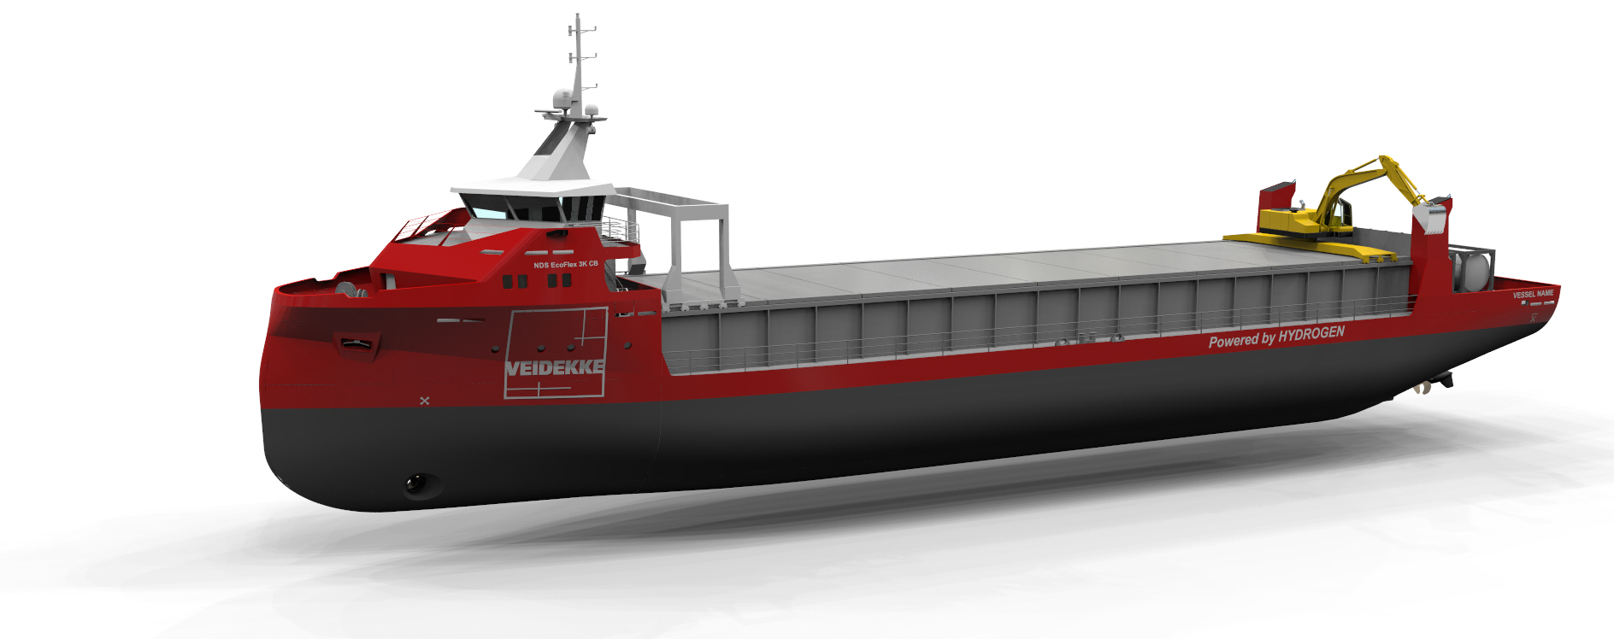
31 rederier konkurrerer om to grønne bulkskip for Veidekke
Arendals Dampskibsselskap
Amon Maritime AS / Viridis Bulk Carriers
Blue Star Group
Buksér og Berging AS
CMB Group
Eides Rederi
Farstad Shipping
Frøy Gruppen
Gard Shipping AS
Grieg Maritime Group
Grøntvedt Shipping AS
Hagland Dry Cargo
Lighthouse Ship Management
Intership Navigation Co
Møre Logistic AS
Høyland Offshore AS
OSM Maritime Group
Peak Shipping
Peter Gast Shipping GmbH / Vega Rederei
Roslagen AS
Seaworks
Thor Dahl Shipping
Torhus Shipping
Wagenborg Shipping B V
Xxx - reservert seg mot publisering
Xxx - reservert seg mot publisering
Xxx - reservert seg mot publisering
Xxx - reservert seg mot publisering
Xxx - reservert seg mot publisering
Xxx - reservert seg mot publisering
Xxx - reservert seg mot publisering

